Slide 1

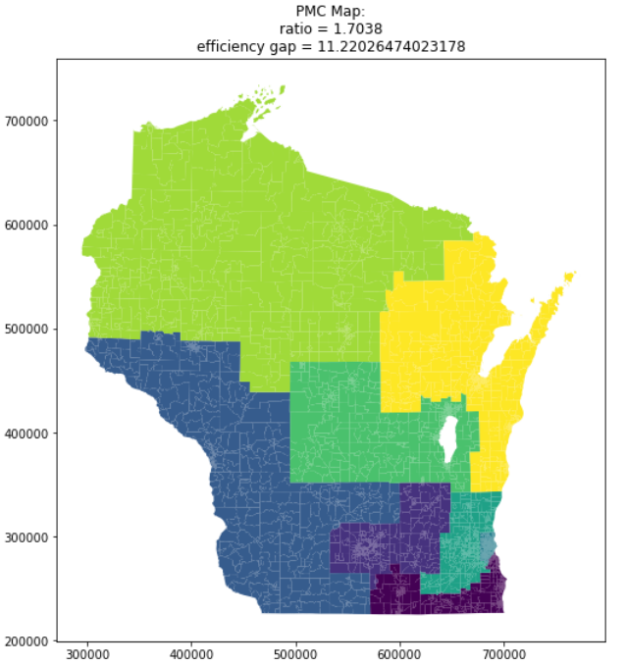

Overview
Please select TWO proposals from box below
Please click on ONE variable to see it on the map!
Max Efficiency Gap
* Activate Tutorial
PMC Map
Eff Gap Modularity Compactness % White % Black % Dem Vote 2020 Ave Income
In-use
Current District Map
* Currently displaying Efficiency Gap on both maps
* Each line represent a single district
* Two color hues, each for one proposal
* Click the line to see the district on the map, highlighted
Optimized
Max Efficiency Gap
* 3D Button for unclicked status
* Once clicked, change button style and make the text bold
Max Modularity
* Click the question mark to jump down to the explanation
* Disable button clicking when users click the mark
Max Compactness
PMC Map
Overlay options:
1. Currently enacted map boundaries
2. 2010 district boundaries
3. OSM Street Map
4. CBGs in overlapped boundaries
Efficiency Gap
* The legend is also a widget for filter
Max Efficiency Gap
PMC Map
* Scroll for more info
Efficiency Gap
* Reexpress to Choropleth Map, Proportional Symbol Map or Bar Chart
1
1
1
1
8
* The same order as in the box above
2
2
*Actually zoom in would have CBG outlines, GEOIDs, and a district border outline. Color stays the same
3
3
4
4
5
5
6
6
7
7
Notes:
Model of the front page: Eviction Map & Data | Eviction Lab

Slide 2
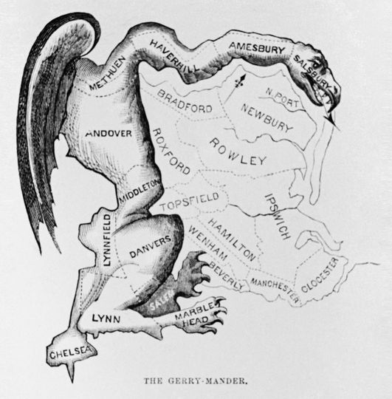
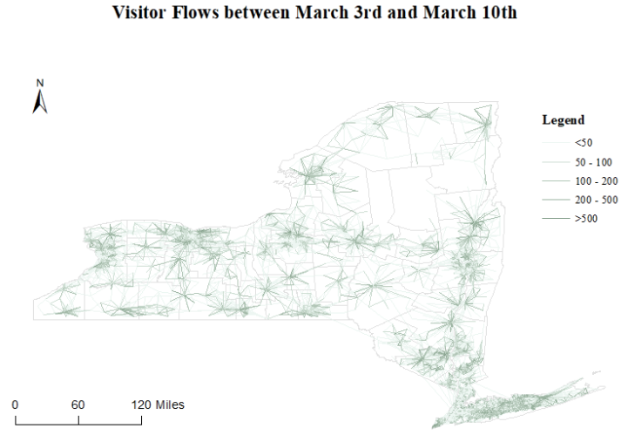
Tutorial
Please select TWO proposals from box below
Please click on ONE variable to see it on the map!
Max Efficiency Gap
Current District Map
Eff Gap Modularity Compactness % White % Black % Dem Vote 2020 Ave Income
In-use
Current District Map
* Lead the users to learn how the website works
* Only one card at a time in implementation
* The tutorial can also pop when click the upper-right question mark
Optimized
Max Efficiency Gap
Max Modularity
Gerrymandering primer
Purpose of this research
Map settings
Map Exploration
Max Compactness
Show tradeoffs between redistricting criteria – can’t optimize for all at the same time
Use mobility flow data to include real measures of community rather than just administrative boundaries
Select two proposals
Select the variable to show on both maps
Move the thumb to filter
Change map or diagram type
Add or hide layers
Zoom and pan to local areas
Click to see detailed info
PMC Map
CBGs of difference
Efficiency Gap
Max Efficiency Gap
…
Current District Map
Current District Map
1
2
Current District Map
Efficiency Gap
Data
xxx
…
…
xxx
5
1
1
1
* Hide until two maps and variables are set up
1
1
2
3
8
5
4
2
2
3
3
4
4
5
5
6
6
7
7
Notes:
Model of the front page: Eviction Map & Data | Eviction Lab

Slide 3
Initialization
Please select TWO proposals from box below
Please click on ONE variable to see it on the map!
Max Efficiency Gap
Current District Map
Eff Gap Modularity Compactness % White % Black % Dem Vote 2020 Ave Income
In-use
Current District Map
* Show the comparison of two typical proposals after walking through the tutorial.
Optimized
Max Efficiency Gap
Max Modularity
Max Compactness
PMC Map
CBGs of difference
Efficiency Gap
Max Efficiency Gap
Current District Map
1
1
1
1
8
8
2
2
3
3
4
4
5
5
6
6
7
7
Notes:
Model of the front page: Eviction Map & Data | Eviction Lab

Slide 4
Filter
Please select TWO proposals from box below
Please click on ONE variable to see it on the map!
Max Efficiency Gap
PMC Map
Unselected
Eff Gap Modularity Compactness % White % Black % Dem Vote 2020 Ave Income
In-use
Current District Map
Optimized
Max Efficiency Gap
Max Modularity
Max Compactness
PMC Map
* Add Legend for the unselected districts
Unselected
Efficiency Gap
Max Efficiency Gap
PMC Map
1
1
1
1
8
2
2
3
3
4
4
5
5
6
6
7
7
Notes:
Model of the front page: Eviction Map & Data | Eviction Lab

Slide 5
Please select TWO proposals from box below
Please click on ONE variable to see it on the map!
-
Highlight
Max Efficiency Gap
PMC Map
Eff Gap Modularity Compactness % White % Black % Dem Vote 2020 Ave Income
In-use
Current District Map
Optimized
Max Efficiency Gap
Max Modularity
Max Compactness
PMC Map
Efficiency Gap
Max Efficiency Gap
PMC Map
1
1
1
1
8
2
2
3
3
4
4
5
5
6
6
7
* Double click to zoom and pop up details
7
Notes:
Model of the front page: Eviction Map & Data | Eviction Lab

Slide 6
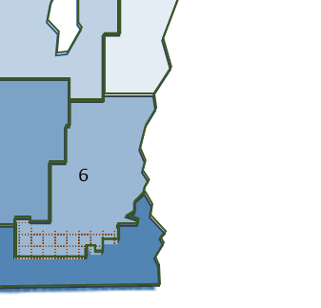
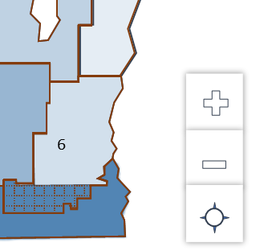
Please select TWO proposals from box below
Please click on ONE variable to see it on the map!
-
Zoom in and popup
Max Efficiency Gap
PMC Map
Eff Gap Modularity Compactness % White % Black % Dem Vote 2020 Ave Income
In-use
Current District Map
Optimized
Max Efficiency Gap
Max Modularity
Max Compactness
PMC Map
Efficiency Gap
Max Efficiency Gap
PMC Map
Data
…
…
* Show smaller spatial units
Notes:
Model of the front page: Eviction Map & Data | Eviction Lab

